Slide 1

Gulf Coast Enterprises ITTP Program DMDC and SDLC
An Overview of the Application Development Process at DMDC
Lunch and Learn
August 05, 2015
ITTP-F-D-401-1

Slide 2
Welcome
Introductions
Icebreaker
Agenda and Housekeeping

Slide 3
Agenda
Objectives
Background
Software design and High Level Process Review
Phases and Stages, and Bears, Oh My!
Roles and more Roles
Review and Discussion
Phases and Deliverables
Review and Wrap-up

Slide 4
Objectives
At the end of this session you should be able to:
Identify and describe the four phases of the DMDC Application Development Process
Within each phase of the Development Process, describe one or more major stages
Describe at least three activities/responsiblilities within the process for each of these roles: Business Analyst, Developer, QA Tester
Explain the following abbreviations/acronymns: CM, CVS, IAB, DMAG, TRB, TSG
Name two key project artifacts a PM develops in Phase B
Locate and use the DMDC Application Development Process

Slide 5
Definition of Software Engineering (IEEE)
Software Engineering is the application of a systematic, disciplined, quantifiable approach to the development, operation and maintenance of software.
This material is derived from the DMDC Application Development Process. It is located at the site listed below.
Abstract | This document describes the generic process for application development at DMDC.
Document Date | October 2011
Document Version | 1.4
Document Location | http://iweb2.ds.dhra.osd.mil/sites/TSG/SitePages/Home.aspx

Slide 6
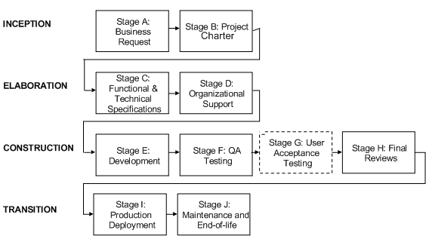
DMDC Software Development Process

Slide 7
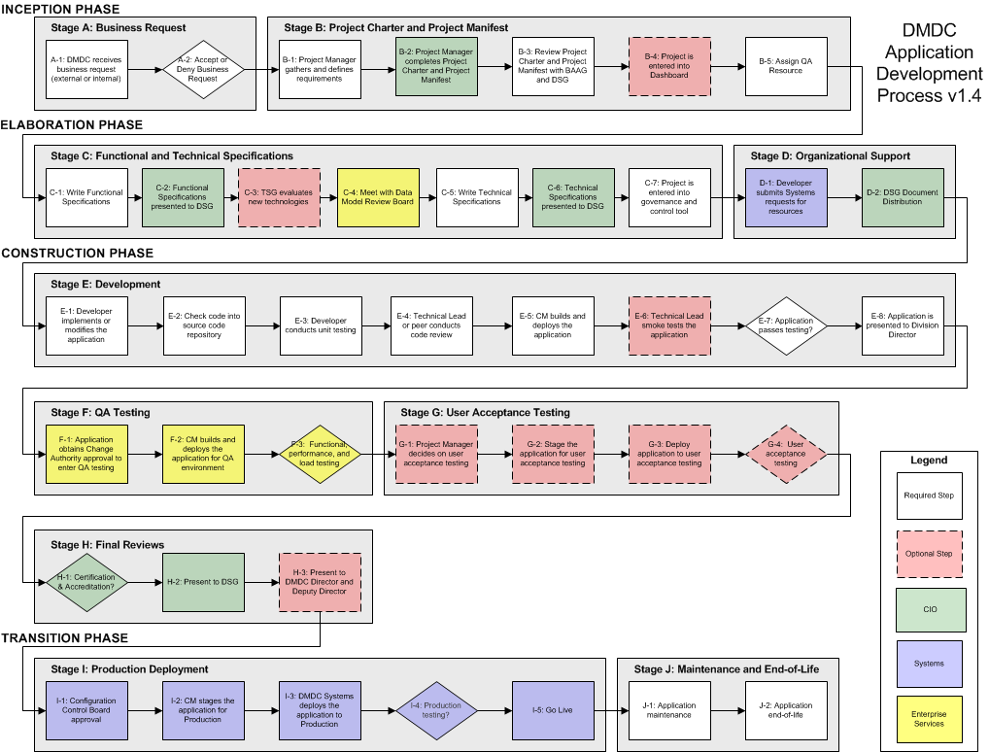
DMDC Software Development Process

Slide 8
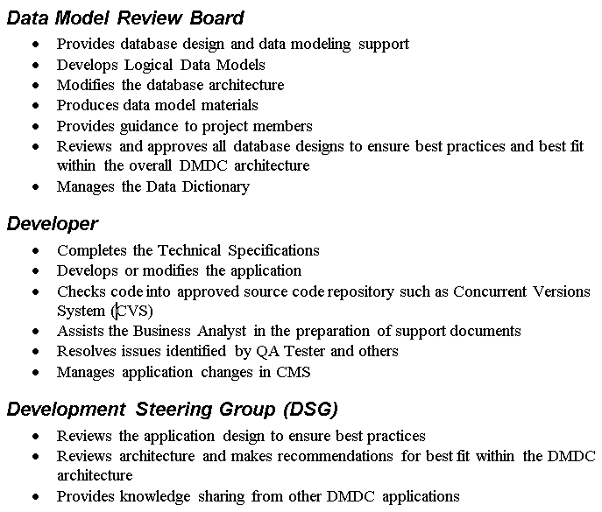
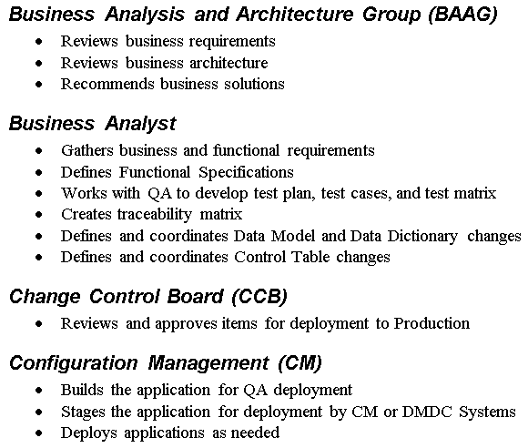
Roles in the Process

Slide 9
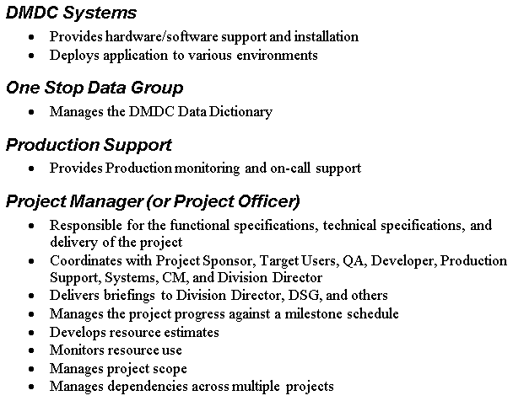
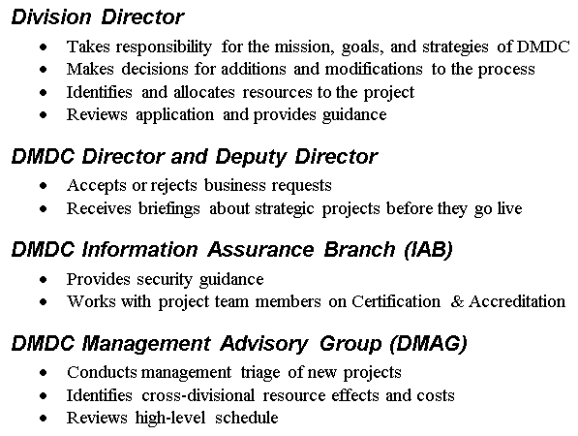
Roles in the Process

Slide 10
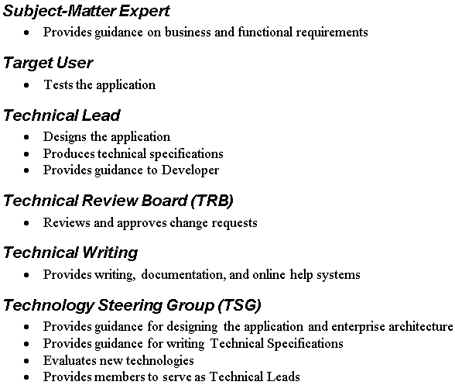
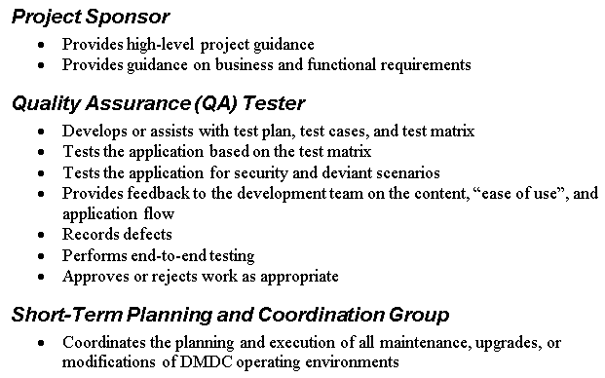
Roles in the Process

Slide 11
Review
The _____ works with the QA to develop test plan, test cases, and test ______.
The _______ checks code into approved source code repository (such as CVS).
The PM manages the project’s ________ against a milestone schedule.
_____________provides production monitoring and on-call support.
The ________provides feedback to the dev team on the content, “ease of use” and application flow.
Notes:
The __BA___ works with the QA to develop test plan, test cases, and test _matrix_____.
The __developer_____ checks code into approved source code repository (such as CVS).
The PM manages the project’s _progress_______ against a milestone schedule.
_Production support__provides production monitoring and on-call support.
The _QA tester_provides feedback to the dev team on the content, “ease of use” and application flow. QA tester

Slide 12




Inception Phase – Key Deliverables
Project Charter
Business Goals & Objectives
Project Sponsor & Key Stakeholders
Roles/Responsibilities
Project Management Plan
WBS (Work Breakdown Structure)
Communications Plan
Configuration Management Plan
Risk Management Plan
Quality Plan
Test Plan

Slide 13
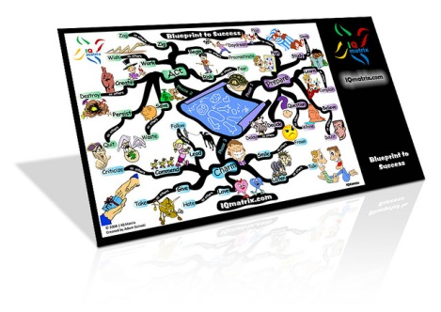


Elaboration Phase – Key Deliverables
Functional & Technical Specifications
Requirements Specification (As-Is & To-Be)
Use Cases
User Stories
Data Models
Process Models
Requirements Traceability Matrix
Test Cases
Interface Specifications
Performance Specifications

Slide 14
Eight Properties of Good Requirements
Correct and complete
Understandable by the target audience
Consistent
Unambiguous
Verifiable/Testable
Sufficient for design
Traceable
Feasible

Slide 15
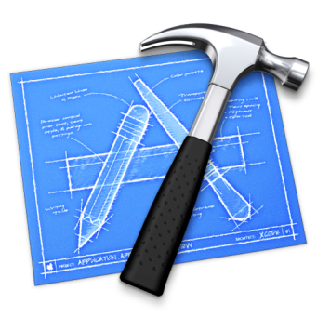
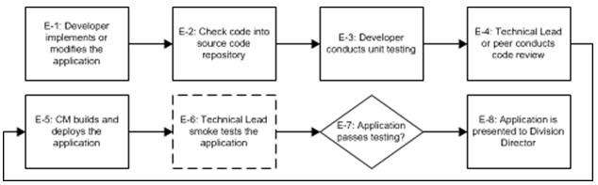



Construction Phase – Key Deliverables
Code
Test Results

Slide 16



Transition Phase – Key Deliverables
Deploy system to production environment

Slide 17
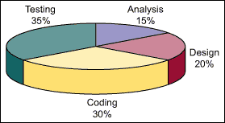
ROM Timeline Estimates of SDLC Phases

Slide 18
Review – Match
CM
TRB
TSG
IAB
CVS
DMAG
SWOT
Builds the app for QA deployment
Provides guidance for writing Technical Specifications
A technique for analysis of current conditions
Identifies cross-divisional resource effects and costs
Reviews and approves change requests
Provides security guidance
Enterprise source code control
Notes:
“Match the number and term on the left with the statement on the rignt”
Answer Key: 1, 3, 7, 6, 2, 4, 5
Builds the app for QA deployment CM (page 4)
Provides guidance for writing Technical Specifications TSG (p7)
A technique for analysis of current conditions swot (wildcard)
Identifies cross-divisional resource effects and costs dmag (p5)
Reviews and approves change requests trb (p7)
Provides security guidance iab (5)
Enterprise source code control cvs (p11)

Slide 19
Review
Which terms identify the phases of the app development process?
Illumination
Deployment
Testing
inception
Development
Idea
clarification
construction
transition
elaboration
Build-out

Slide 20
Review
Which terms identify the phases of the app development process?
Illumination
Deployment
Testing
inception
Development
Idea
clarification
construction
transition
elaboration
Build-out

Slide 21
Review – Inception, Elaboration, Construction, Transition Phases
Place an I, E, T, or C next to the stage:
---Project Charter
----Final Reviews
----Maintenance
---- Development
---- Project Manifest
---- Devolvement
___ UAT
Place a B, Q or D by the task:
--- Record defects
---Create traceability matrix
--- Coordinates Data Dictionary changes
---- Manages application changes in CMS
---- Modifies the code in production
---- Completes technical specs

Slide 22
Review – Chuckles
T/F:
---- CVS is a pharmacy and code repository
---- developers can improve functions as they write code
----- The BA is the most important role
------ The QA tester is the most important role
------ The Developer is godlike
---- DMDC needs more roles in the process

Slide 23
Questions? – Thank You!

